Slide 1
Level Measurement

Slide 2


Slide 3
Level measurements are broadly classified in two groups:
Direct methods
Indirect methods
In Direct methods, the level is indicated directly by means of simple mechanical devices.
The measurement is not affected by changes in material density.
Few examples are:
Dip Stick
Resistance Tapes
Sight Glass
Floats
Ultrasonic
Radar
In Indirect methods, the level is converted in a measurable signal using a suitable transducer.
Change in the material affects the measurement.
A corrective factor must be used in recalibrating the instrument. Few examples are:
Hydrostatic head methods
Load cell
Capacitance
Conductivity

Slide 4
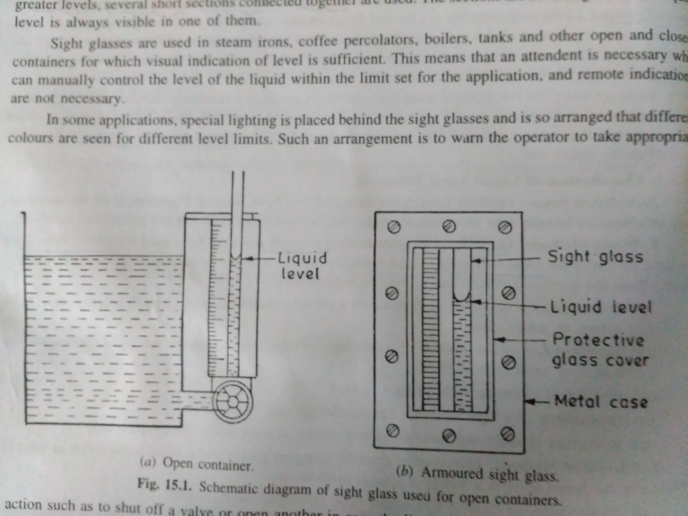
Sight Glass: Direct Visual method
a very simple and effective technology for direct visual indication of process level
a level gauge is nothing more than a clear tube through which process liquid may be seen.
Measurement of level of non-corrosive and non staining or non-sticky liquids.
The slight glasses are used to measure liquid levels upto about 1m.
Notes:
Lights are provided in some cases

Slide 5
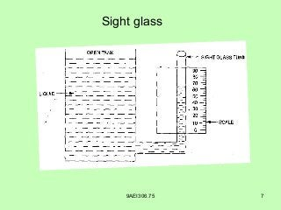

Slide 6
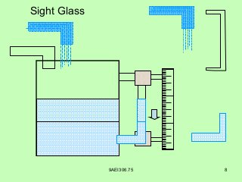

Slide 7
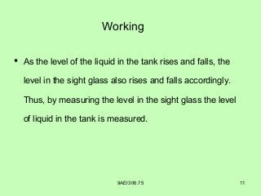

Slide 8
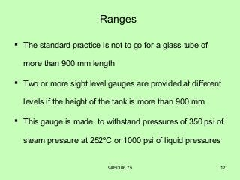

Slide 9
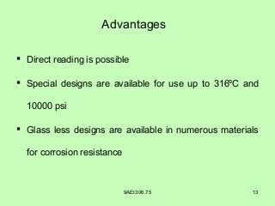

Slide 10
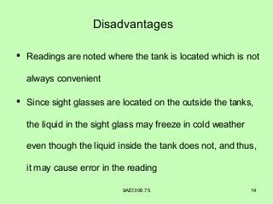

Slide 11
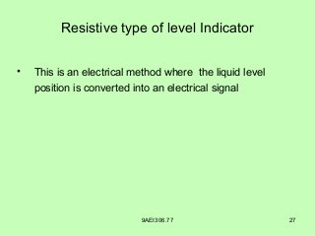

Slide 12
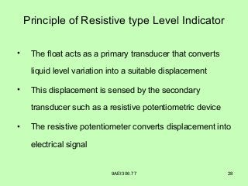

Slide 13
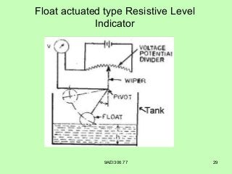

Slide 14
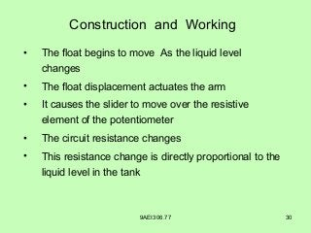

Slide 15
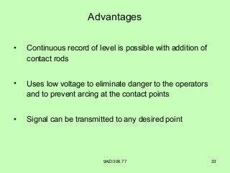

Slide 16
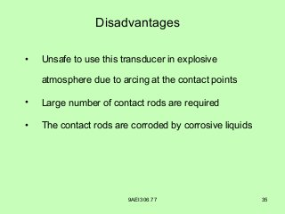

Slide 17
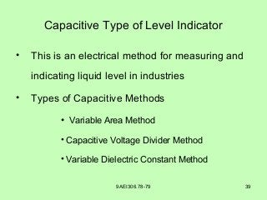

Slide 18
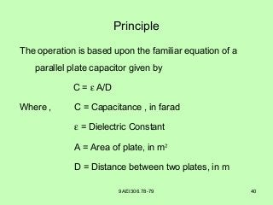

Slide 19


Slide 20
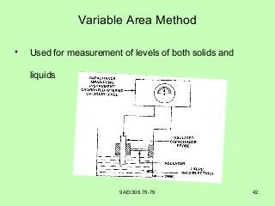

Slide 21
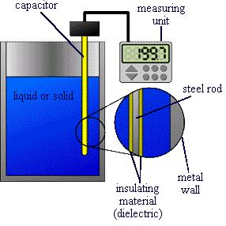

Slide 22


Slide 23
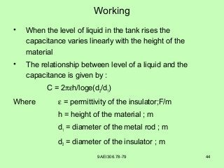

Slide 25
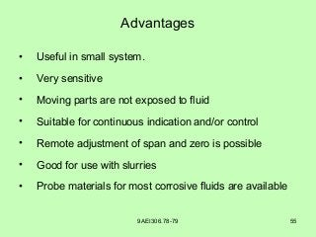

Slide 26
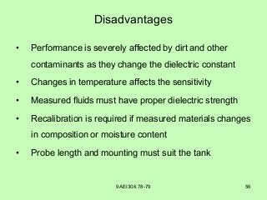

Slide 27
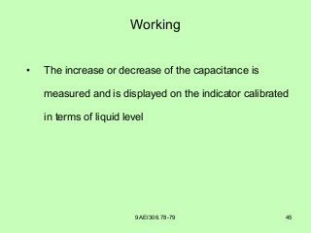

Slide 29
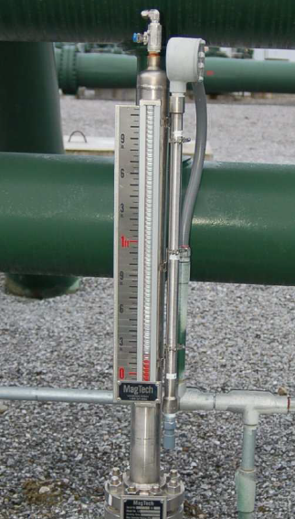
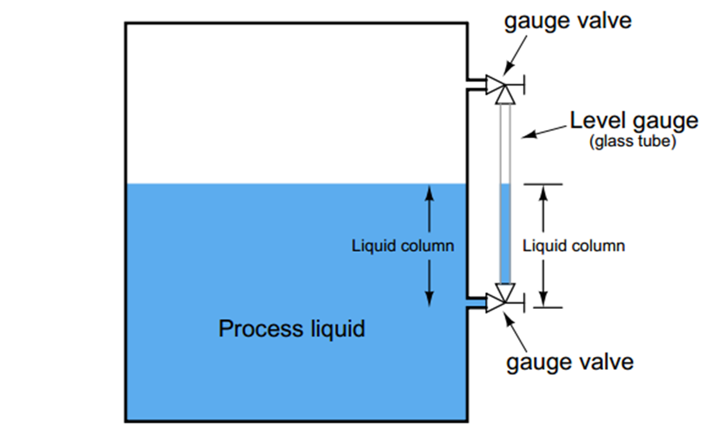

Slide 30
What are the different types of level measurement?
Level measurement using hydrostatic pressure.
Displacer type level measurement.
Ultrasonic level measurement.
Radar level measurement.
Float level detectors.
Capacitive level measurement.
Nuclear level measurement.
Laser level measurement.

Slide 31
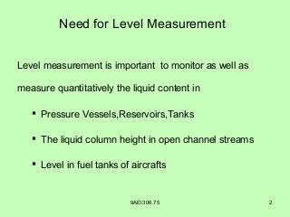

Slide 32
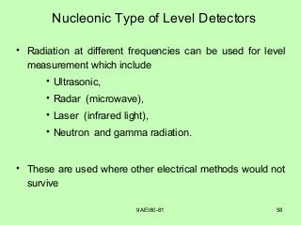

Slide 33
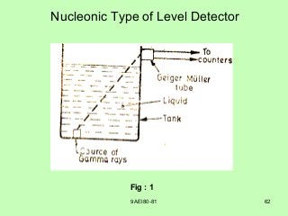

Slide 34
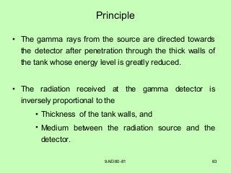

Slide 35
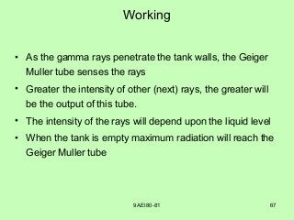

Slide 36
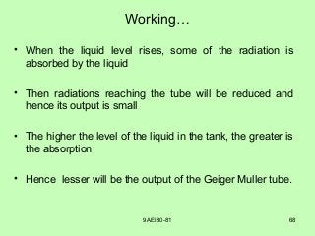

Slide 37
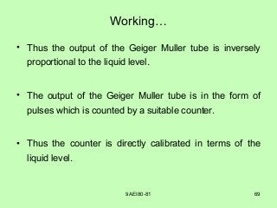

Slide 38
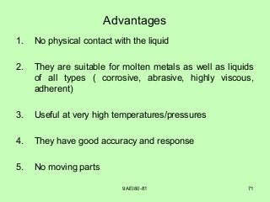

Slide 39
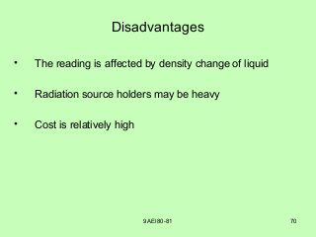

Slide 40
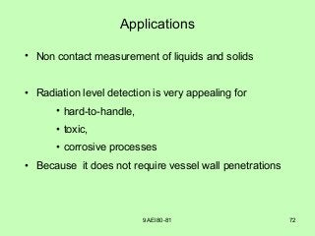

Slide 41
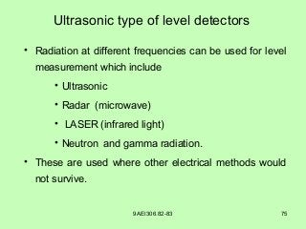

Slide 42
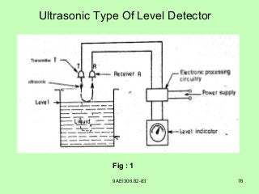

Slide 43
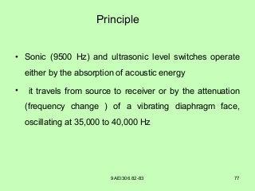

Slide 44
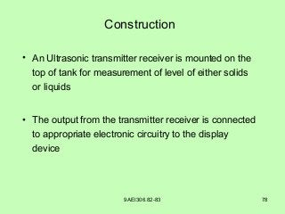

Slide 45
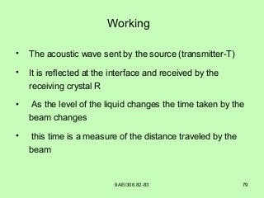

Slide 46
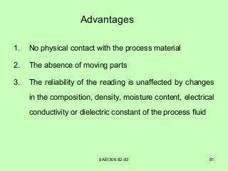

Slide 47
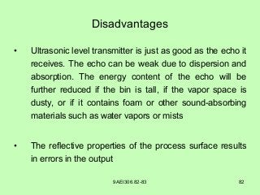

Slide 48
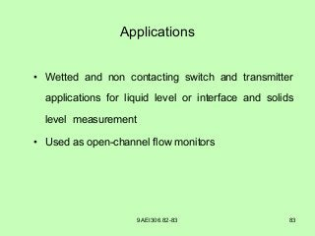

Slide 49
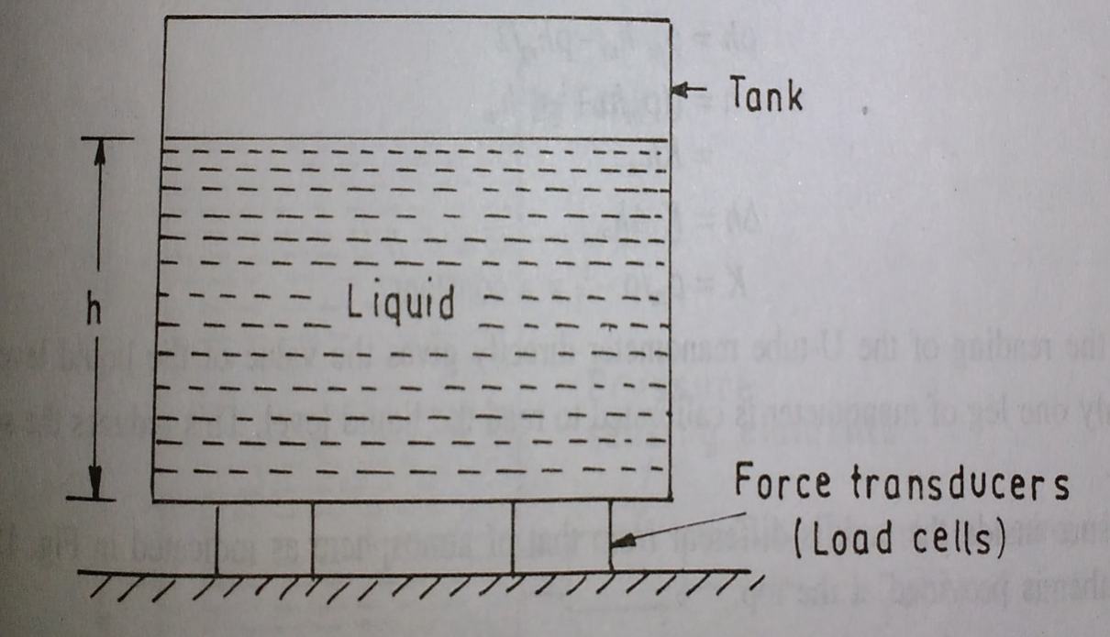
Force operated methods
F=mg=ρVg= ρAgh
P=F/A
Notes:
Force and pressure are proportional to liquid head

Slide 50
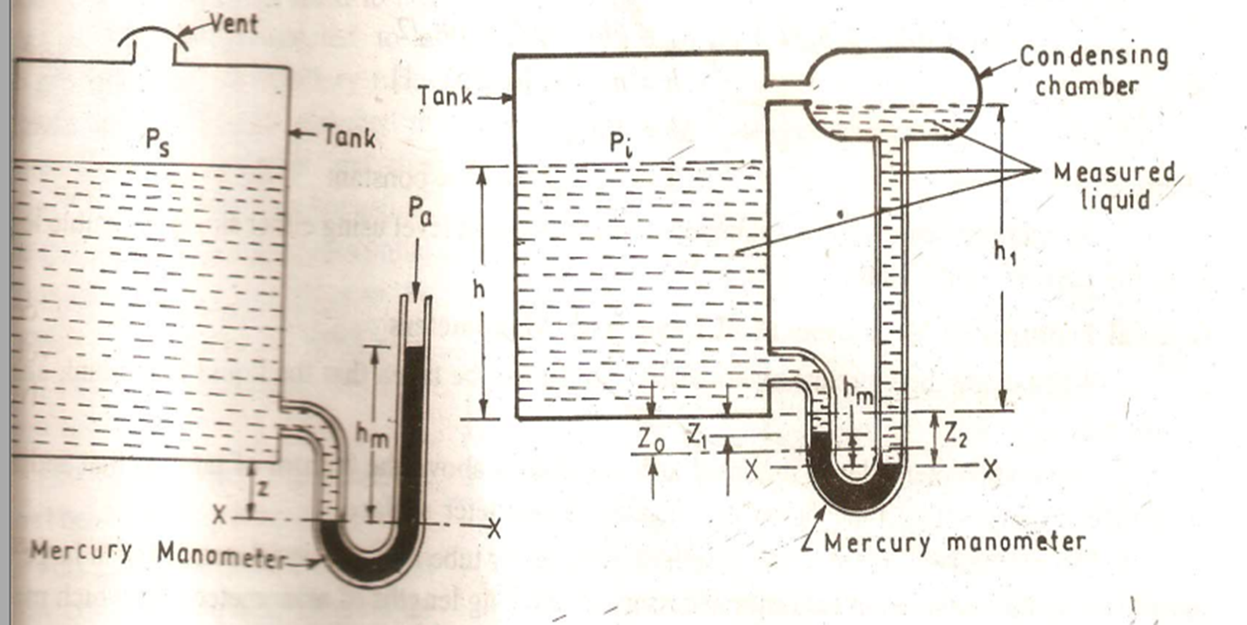
By using mercury manometers

Slide 51
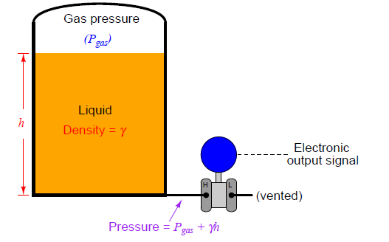
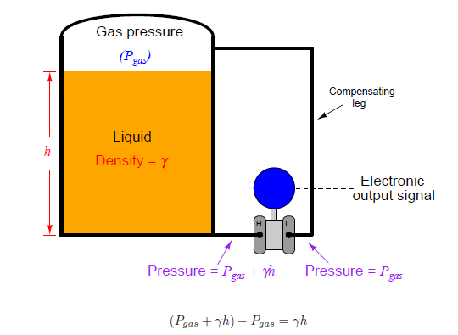

Slide 52
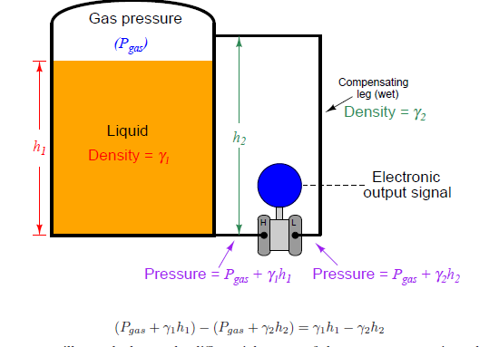
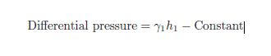

Slide 53
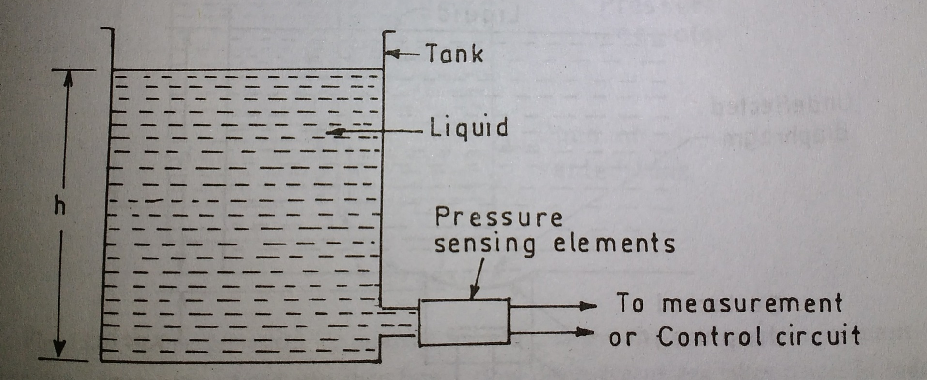
Pressure transducers
Bourdon tube, bellows, diaphragms etc…

Slide 54
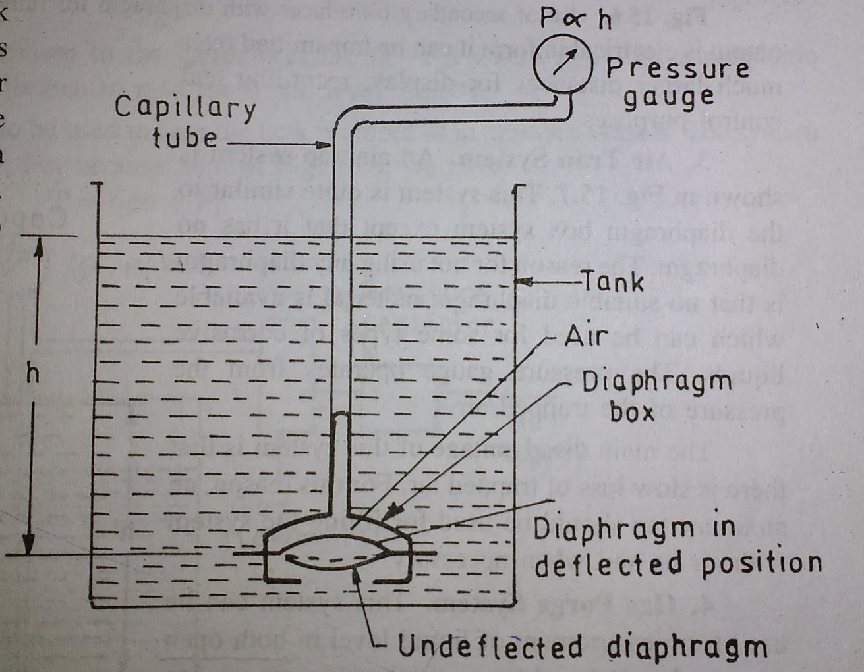
Diaphragm box
Thin diaphragm and the
system is filled with air.

Slide 55
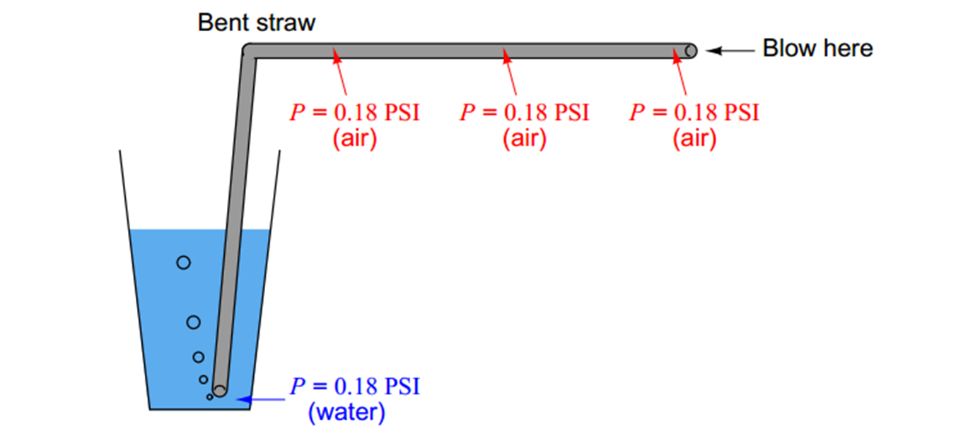

Gas purge system

Slide 56


Slide 57


Slide 58


Slide 59

ELECTRICAL METHODS

Slide 60

Reed switch

Slide 61

Capacitance level sensors
Capacitance level detectors are also referred to as radio frequency (RF) or admittance level sensors. They operate in the low MHz radio frequency range, measuring admittance of an alternating current (ac) circuit that varies with level.
If the area (A) of and the distance (D) between the plates of a capacitor remain constant, capacitance will vary only as a function of the dielectric constant of the substance filling the gap between the plates.
If a change in level causes a change in the total dielectric of the capacitance system, because the lower part of area (A) is exposed to a liquid (dielectric Kl) while the upper part is in contact with a vapor (dielectric Kv, which is close to 1.0), the capacitance measurement will be proportional to level.

Slide 62

Capacitance level switch(probe)
In the case of a horizontally mounted level switch ,a conductive probe forms one of the plates of the capacitor (A1), and the vessel wall (assuming it is made from a conductive material) forms the other (A2).
An insulator with a low dielectric constant is used to isolate the conductive probe from the housing, which is connected to the vessel wall. The probe is connected to the level sensor via the conductive threads of the housing.
Measurement is made by applying an RF signal between the conductive probe and the vessel wall
The RF signal results in a minute current flow through the dielectric process material in the tank from the probe to the vessel wall.
When the level in the tank drops and the probe is exposed to the even less conductive vapors, the dielectric constant drops. This causes a drop in the capacitance reading and a minute drop in current flow.
This change is detected by the level switch's internal circuitry and translated into a change in the relay state of the level switch

Slide 63


Measurement of electrically non-conductive materials:
The capacitor is made by electrode of the sensor and the wall. The dielectric is done by air or the material

Slide 64
Measurement of electrically conductive materials:
The capacitor is made by electrode of the sensor
and the material . Dielectric is done by the insulation of the electrode

Slide 65


Gamma ray detectors: GM counter

Slide 66





Ultrasonic level measurement

Slide 67



Measurement of liquid level in dynamic environment (effect of slash)

Slide 68

The raw sensor signals were smoothened or filtered to remove high-frequency noise and spikes before processing the sensor signals through the SVM based signal processing method
Support Vector Machine (SVM) is a newly developed machine learning algorithm.SVM is based on Statistical Learning Theory and has the ability to recognise patterns

Slide 69
Humidity measurement

Slide 70

Humidity is amount of water vapor present in air
Water vapor is usually expressed in terms of relative humidty(RH),
Dew point or wet bulb temperature and volume or mass ratio,
Expressed as part per million(ppm) volume or weight.
Dew point—Saturation temperature of a gas–water vapor
mixture (the temperature at which water condensation
occurs as a gas is cooled).
Relative humidity(RH)- The ratio of how much water vapor is in the air vs. the maximum it could contain at the particular temperature
Hygrometer—An apparatus that measures humidity
Specific humidity—The ratio of the mass of water vapor
to the mass of dry gas in a given volume

Slide 71


Warm air has a greater capacity for water vapor than does cold air

Slide 72
Applications of humidity measurements
Many domestic applications, such as intelligent control of the living environment in buildings, cooking control for microwave ovens, and intelligent control of laundry etc.
In automobile industry, humidity sensors are used in rear window defoggers and motor assembly lines.
In medical field, humidity sensors are used in respiratory equipment, sterilizers, incubators, pharmaceutical processing, and biological products.
In agriculture, humidity sensors are used for green-house air-conditioning, plantation protection (dew prevention), soil moisture monitoring, and cereal storage.
In general industry, humidity sensors are used for humidity control in chemical gas purification, dryers, ovens, film desiccation, paper and textile production, and food processing.

Slide 73

Certain hygroscopic materials such as human hair, animal membranes, wood, paper, etc., undergo changes in linear dimensions when they absorb moisture from their surrounding air. This change in linear dimension is used as the measurement of humidity present in air.
When the humidity of air is to be measured, this air is made to surround the hair arrangement and the hair arrangement absorbs the humidity from the surrounding air and expands or contracts in the linear direction.
This expansion or contraction of the hair arrangement moves the arm & link and thus the pointer to a suitable position on the calibrated scale and thus indicating the humidity present in the air/atmosphere

Slide 74

The dew point is the temperature when water vapor starts to condense out of air.(the temperature at which air becomes completely saturated)
Above this temperature moisture stays in the air
If the dew point temperature is close to dry air temperature –the relative humidity is high
If the dew point is well below the dry air temperature –the relative humidity is low

Slide 75
The mirror is constantly cooled by a cooling medium. The cooling medium is maintained at a constant temperature.
To this mirror is attached a thermocouple whose leads are connected to a millivoltmeter.
Constantly a light is made to fall in an angle on the mirror and the amount of reflected light is sensed by a photo cell.
Now an air jet is made to fall in an angle on the mirror and the water-vapor (moisture) contained in the air starts condensing on the mirror and they appear as small drops (dew) on the mirror.
This moisture (dews) formed on the mirror reduces the amount of light reflected from the mirror and it is detected by photocell. When for the first time, there is a change in amount of transmitted light; it becomes an indication of dew formation.
At this instance (that is, when the due formation is detected first), the temperature indicated by the thermocouple attached to the mirror becomes the dew point temperature.
Thus this arrangement is used to determine the time at which the dew appears for the first time and dew point temperature.

